Slide 1

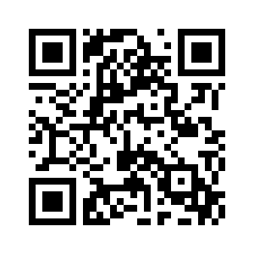




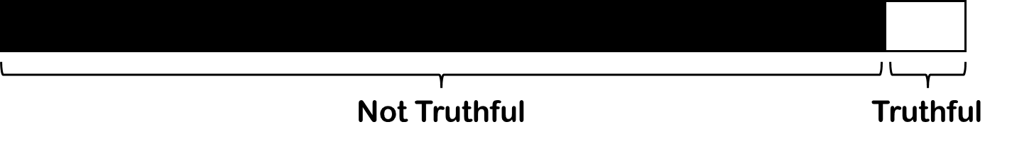
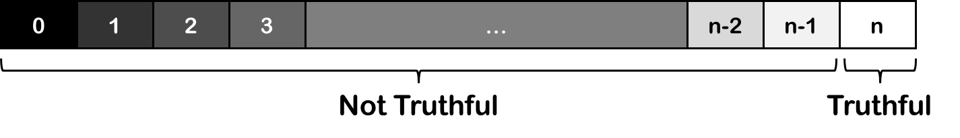

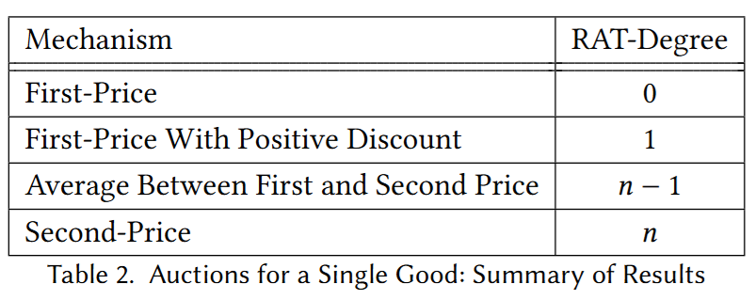
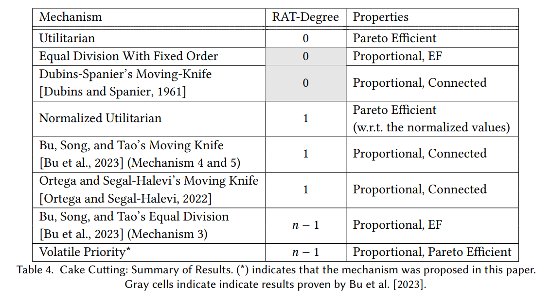
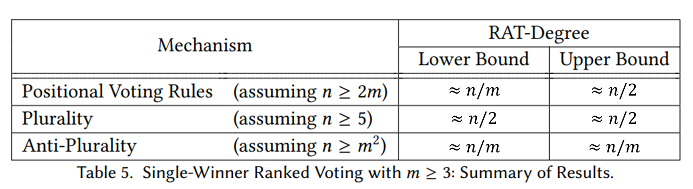


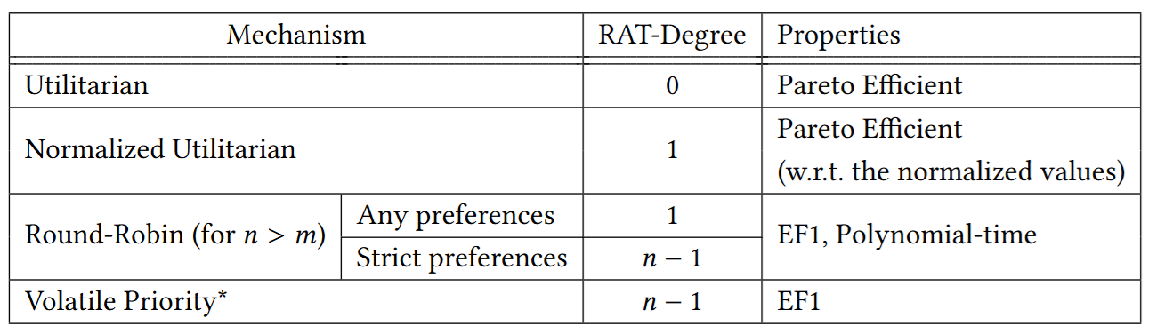

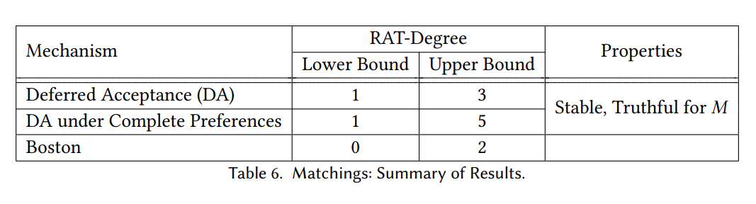

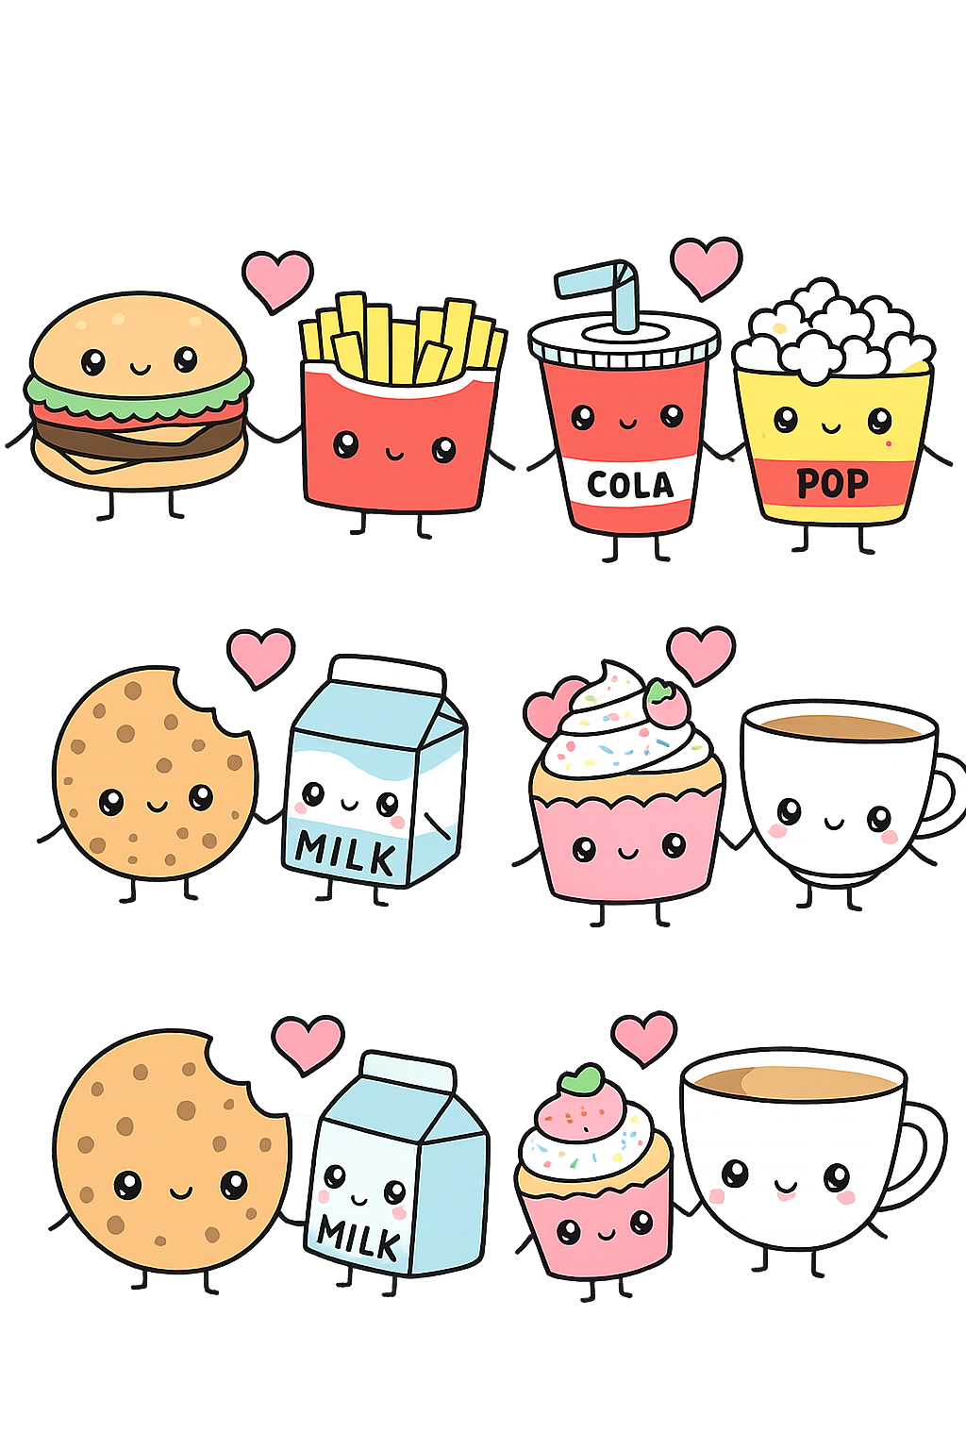
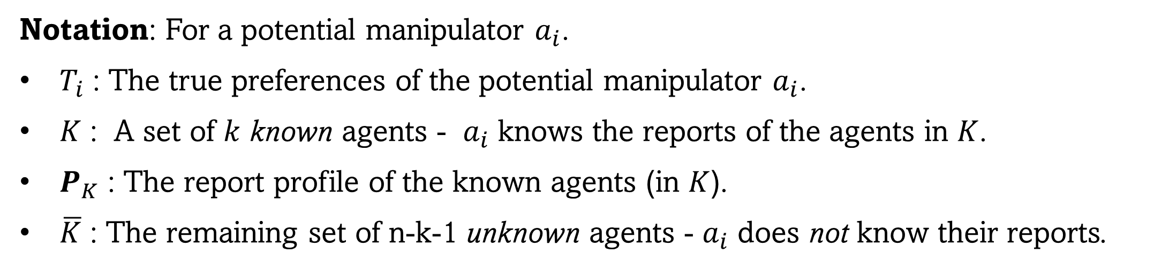
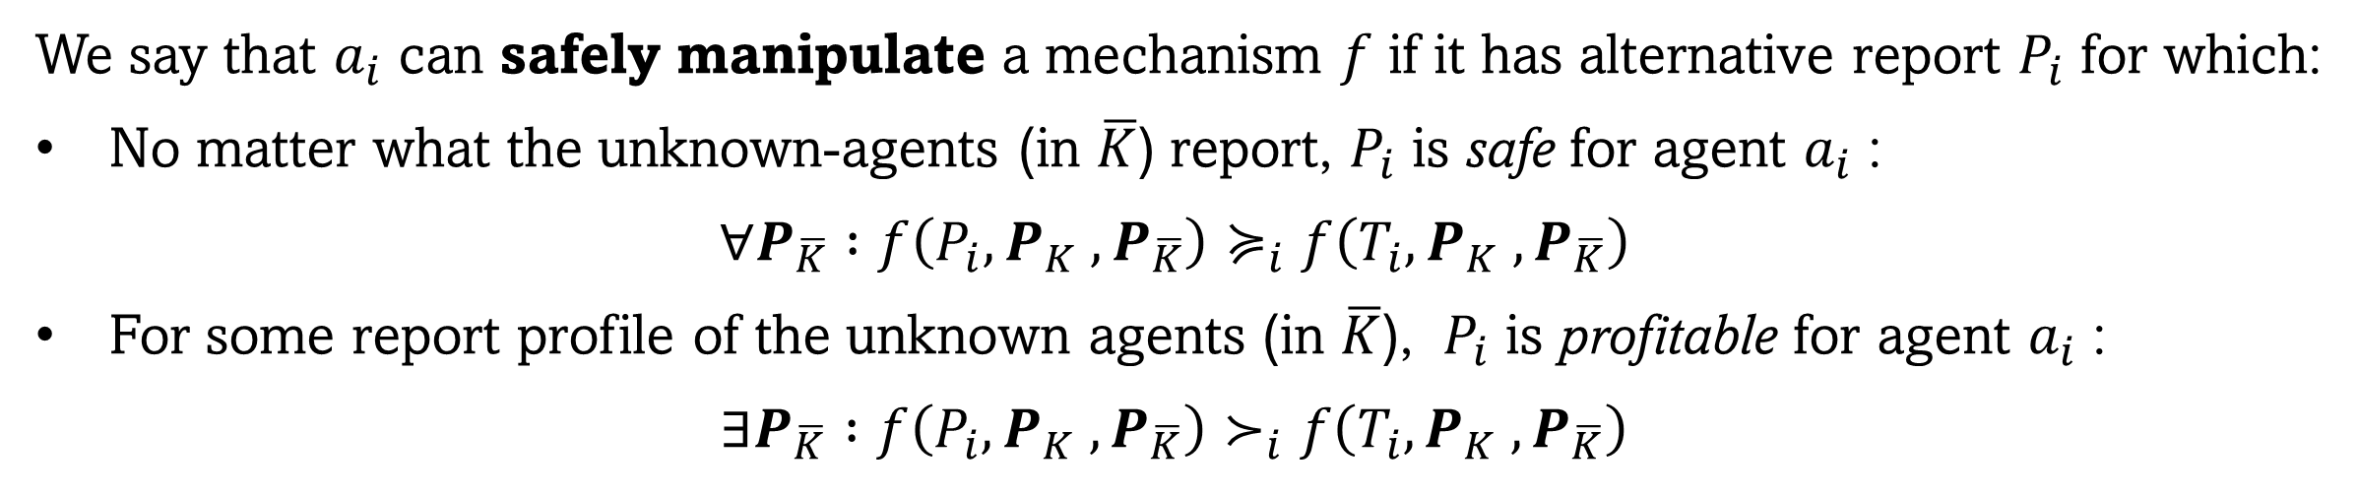
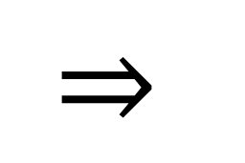
It’s Not All Black and White:
Degree of Truthfulness for Risk-Avoiding Agents
Eden Hartman
Bar-Ilan University
Erel Segal-Halevi
Ariel University
Biaoshuai Tao
Shanghai Jiao Tong
arXiv 2502.18805
Goal:
Design mechanisms that are less likely to be manipulated.
Assumptions:
Risky manipulations are less likely.
Collecting information on others is costly.
Solution:
Design mechanisms that require a lot of information to manipulate safely.
We evaluate mechanisms by their RAT-Degree:
Smallest number of agents whose reports, if known, allow another agent to safely manipulate
[If knowing the reports of all n−1 other agents is still insufficient, we define RAT-Degree = n]
What is the minimum number of agents one must spy on??
Notation: For a potential manipulator $a_{i}$.
$T_{i}$ : The true preferences of the potential manipulator $a_{i}$.
$K$ : A set of $k$ known agents - $a_{i}$ knows the reports of the agents in $K$.
$P_{K}$ : The report profile of the known agents (in $K$).
$\overline{K}$ : The remaining set of n-k-1 unknown agents - $a_{i}$ does not know their reports.
We say that $a_{i}$ can safely manipulate a mechanism $f$ if it has alternative report $P_{i}$ for which:
No matter what the unknown-agents (in $\overline{K}$) report, $P_{i}$ is safe for agent $a_{i}$ :
$∀P_{\overline{K}} :f\left(P_{i},P_{K} ,P_{\overline{K}}\right)≽_{i}f\left(T_{i},P_{K} ,P_{\overline{K}}\right)$
For some report profile of the unknown agents (in $\overline{K}$), $P_{i}$ is profitable for agent $a_{i}$ :
$∃P_{\overline{K}} :f\left(P_{i},P_{K} ,P_{\overline{K}}\right)≻_{i}f\left(T_{i},P_{K} ,P_{\overline{K}}\right)$
Properties
Our approach refines the binary distinction between truthful and untruthful mechanisms into a scale of n+1 values.
$$⇒$$
• Applicable to all social choice settings; • Does not depend on the specific problem or input; • Applicable to cardinal and ordinal valuations.
Previous Definitions: A mechanism f is
Truthful = No manipulation is profitable.
RAT = No manipulation is both profitable & safe.
(Risk-Avoiding Truthful) [Bu, Song, & Tao, 2023]
Relation to previous definition:
RAT-degree = n ⇔ Truthful (best for designer)
RAT-degree = 0 ⇔ Not even RAT (worst for designer)
Higher RAT-degree: more info is needed to manipulate safely (better for designer)
RAT-Degrees of Deterministic Mechanisms: Analysis
Auction for a Single Good
Fair Cake-Cutting
Single-Winner Ranked Voting
For piecewise-constant valuations:
(where $m$ = #candidates)
Efficient; higher expected revenue with risk-avoiding buyers
With three or more candidates, the only truthful rules are dictatorships
[Gibbard, 1973; Satterthwaite, 1975]
OPEN: Combinatorial auctions?
OPEN: non-dictatorial voting rule with RAT-degree >> n/2?
OPEN: Degree of non-positional voting rules?
OPEN: Degree of multi-winner voting rules?
Indivisible Goods Allocation
Proportionality and EF is incompatible with truthfulness [Tao, 2022]
Future Work
More social choice problems:
Combinatorial auctions, Multi-winner voting,
Budget aggregation, Facility location, …
Using other definition for “good” manipulations:
Always profitable [Brams, Jones & Klamler, 2006]
Profitable in best or worst cases [Troyan & T Morrill , 2020]
Different types of information about the known-agents.
Randomized mechanisms.
More definitions:
Safe with-high-probability, bit-RAT-degree….
OPEN: Connected with RAT-degree ≥ 2?
OPEN: Maximum Nash-Welfare Mechanism?
OPEN: Even-Paz Mechanism?
Two-sided Matching
With more than 5 goods, EF1 is incompatible with truthfulness.
[Amanatidis, Birmpas, Christodoulou, and Markakis, 2017]
OPEN: EF1+polytime mechanism with degree n-1?
OPEN: Maximum Nash-Welfare Mechanism?
OPEN: Envy-Elimination Mechanism?
No stable matching mechanism is truthful for all agents [Roth, 1982]
OPEN: Stable with RAT-degree ≥ 6?
OPEN: Highest degree for stable matching mechanisms?
Talk to us!
(*) marks mechanisms introduced in the paper.

